Slide 1
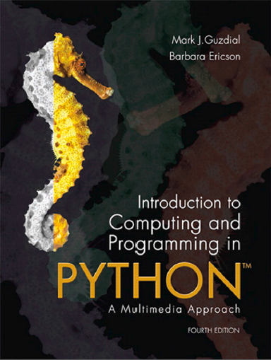
Introduction to Computing and Programming in Python™: A Multimedia Approach
Fourth Edition
Chapter 15
Topics in Computer Science: Speed
Copyright © 2016, 2013, 2010 Pearson Education, Inc. All Rights Reserved
Notes:
If this PowerPoint presentation contains mathematical equations, you may need to check that your computer has the following installed:
1) MathType Plugin
2) Math Player (free versions available)
3) NVDA Reader (free versions available)

Slide 2
Learning Objectives
15.1 To choose between compiled and interpreted programming languages, based on an understanding of machine language and how computers work.
15.2 To know the categories of algorithms based on their complexity and to avoid intractable algorithms.
15.3 To consider processor choice based on an understanding of clock rates.
15.4 To make decisions about computer storage options when aiming for optimizing speed.

Slide 3
What is Fast on a Computer?
What activities are slowest for you on your computer?

Slide 4
Big Speed Differences
Many of the techniques we’ve learned take no time at all in other applications
Select a figure in Word.
It’s automatically inverted as fast as you can wipe.
Color changes in Photoshop happen as you change the slider
Increase or decrease red? Play with it and see it happen live.

Slide 5
Where Does the Speed Go?
Is it that Photoshop is so fast?
Or that Python/Jython is so slow?
It’s some of both—it’s not a simple problem with an obvious answer.
We’ll consider two issues:
How fast can computers get
What’s not computable, no matter how fast you go

Slide 6
What a Computer Really Understands
Computers really do not understand Python, nor Java, nor any other language.
The basic computer only understands one kind of language: machine language.
Machine language consists of instructions to the computer expressed in terms of values in bytes.
These instructions tell the computer to do very low-level activities.

Slide 7
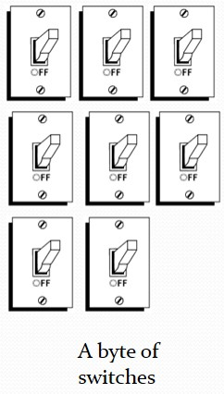
Machine Language Trips the Right Switches
The computer doesn’t really understand machine language.
The computer is just a machine, with lots of switches that make data flow this way or that way.
Machine language is just a bunch of switch settings that cause the computer to do a bunch of other switch settings.
We interpret those switchings to be addition, subtraction, loading, and storing.
In the end, it’s all about encoding.

Slide 8
Assembler and Machine Language
Machine language looks just like a bunch of numbers.
Assembly language is a set of words that corresponds to the machine language.
It’s a one-to-one relationship.
A word of assembly equals one machine language instruction, typically.
(Often, just a single byte.)

Slide 9
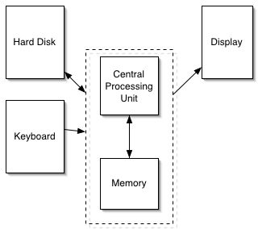
Each Kind of Processor Has its Own Machine Language
Older Apple computers typically used C P U (processor) chips called G3 or G4.
Computers running Microsoft Windows use Pentium-compatible processors.
There are other processors called Alpha, L S I-11, and on and on.
Each processor understands only its own machine language

Slide 10
Assembly Instructions
Assembly instructions tell the computer to do things like:
Store numbers into particular memory locations or into special locations (variables) in the computer.
Test numbers for equality, greater-than, or less-than.
Add numbers together, or subtract them.

Slide 11
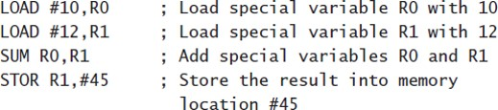
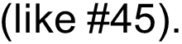
An Example Assembly Language Program
Recall that we talked about memory as a long series of mailboxes in a mailroom.
Each one has a number

Slide 12
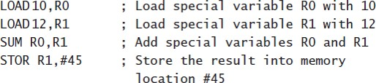
Assembler → Machine
Might appear in memory as just 12 bytes:
01 00 10
01 0112
02 00 01
03 01 45

Slide 13
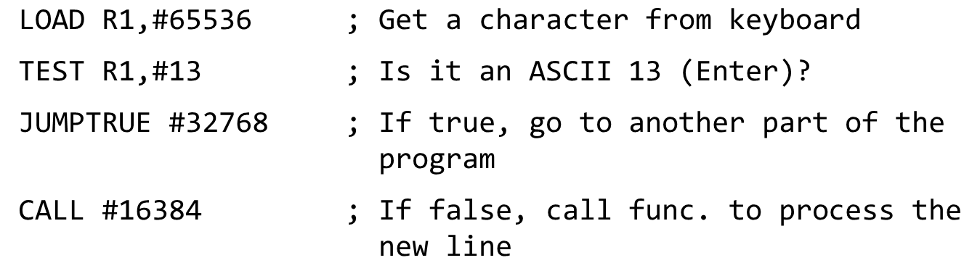
Another Example
Machine Language:
05 01 255 255
10 01 13
20 127 255
122 63 255

Slide 14
Why Don’t We Teach Everyone Assembly Language?
Notes:
Because languages are for people. Assembly language is good for computers, not people.
Because languages are for people. Assembly language is good for computers, not people.

Slide 15
Devices are Also Just Memory
A computer can interact with external devices (like displays, microphones, and speakers) in lots of ways.
Easiest way to understand it (and is often the actual way it’s implemented) is to think about external devices as corresponding to a memory location.
Store a 255 into location 65,542, and suddenly the red component of the pixel at 101,345 on your screen is set to maximum intensity.
Everytime the computer reads location 897,784, it’s a new sample just read from the microphone.
So the simple loads and stores handle multimedia, too.

Slide 16
Machine Language Is Executed Very Quickly
Imagine a relatively slow computer today (not latest generation) having a clock rate of 1.5 Gigahertz.
What that means exactly is hard to explain, but let’s interpret it as processing 1.5 billion bytes per second.
Those 12 bytes would execute inside the computer, then, in
of a second!

Slide 17
Applications are Typically Compiled
Applications like Adobe Photoshop and Microsoft Word are compiled.
This means that they execute in the computer as pure machine language.
They execute at that level speed.
However, Python, Java, Scheme, and many other languages are (in many cases) interpreted.
They execute at a slower speed.
Why? It’s the difference between translating instructions and directly executing instructions.

Slide 18
An Example (1 of 2)
Consider this problem from the book:
Write a function doGraphics that will take a list as input. The function doGraphics will start by creating a canvas from the 640×480.j p g file in the mediasources folder. You will draw on the canvas according to the commands in the input list.
Each element of the list will be a string. There will be two kinds of strings in the list:

Slide 19
An Example (2 of 2)
“b 200 120” means to draw a black dot at x position 200 and y position 120. The numbers, of course, will change, but the command will always be a “b.” You can assume that the input numbers will always have three digits.
“1 000 010 100 200” means to draw a line from position (0, 10) to position (100, 200).
So an input list might look like [“b 100 200”,“b 101 200”,“b 102 200”, “l 102 200 102 300”] (but have any number of elements).

Slide 20
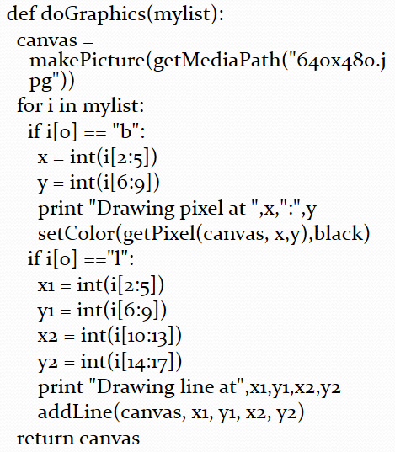
A Sample Solution
This program processes each string in the command list.
If the first character is “b”, then the x and y are pulled out, and a pixel is set to black.
If the first character is “l”, then the two coordinates are pulled out, and the line is drawn.

Slide 21
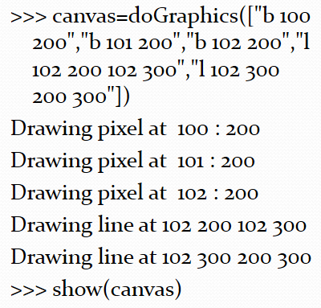

Running do graphic left parenthesis right parenthesis

Slide 22
We’ve Invented a New Language
[“b 100 200”, “b 101 200”, “b 102 200”, “l 102 200 102 300”, “l 102 300 200 300”] is a program in a new graphics programming language.
Postscript, P D F, Flash, and AutoCAD are not too dissimilar from this.
There’s a language that, when interpreted, “draws” the page, or the Flash animation, or the CAD drawing.
But it’s a slow language!

Slide 23
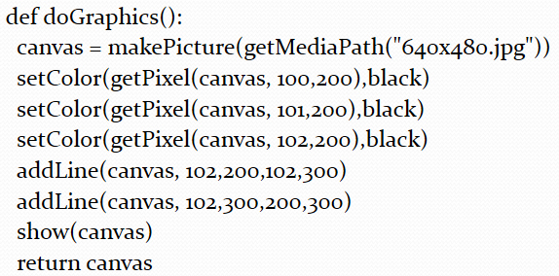
Would This Run Faster?

Slide 24
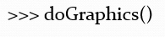
Does the Exact Same Thing

Slide 25
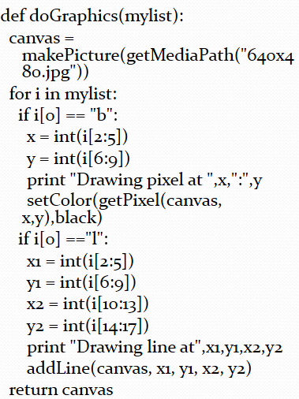
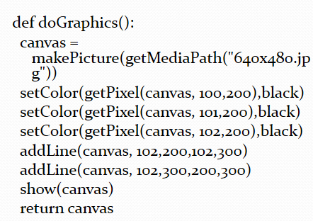
Which Do You Think Will Run Faster?
One just draws the picture.
The other one figures out (interprets) the picture, then draws it.

Slide 26
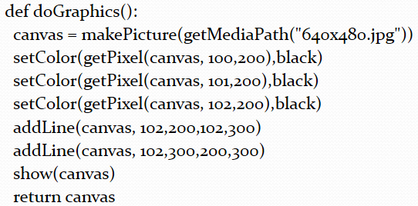
Could We Generate That Second Program?
What if we could write a function that:
Takes as input [“b 100 200”, “b 101 200”,“b 102 200”,“l 102 200 102 300”,“l 102 300 200 300”]
Writes a file that is the Python version of that program.

Slide 27
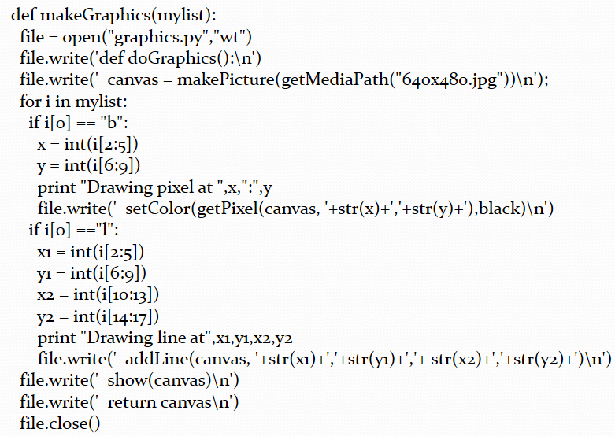
Introducing a Compiler

Slide 28
Why Do We Write Programs?
One reason we write programs is to be able to do the same thing over-and-over again, without having to rehash the same steps in Photoshop each time.

Slide 29
Which One Leads to Shorter Time Overall?
Interpreted version:
10 times
doGraphics([“b 100 200”,“b 101 200”,“b 102 200”,“l 102 200 102 300”,“l 102 300 200 300”]) involving interpretation and drawing each time.
Compiled version
1 time makeGraphics([“b 100 200”,“b 101 200”,“b 102 200”,“l 102 200 102 300”, “l 102 300 200 300”])
Takes as much time (or more) as intepreting.
But only once
10 times running the very small graphics program.

Slide 30
Applications are Compiled
Applications like Photoshop and Word are written in languages like C or C++
These languages are then compiled down to machine language.
That stuff that executes at a rate of 1.5 billion bytes per second.
Jython programs are interpreted.
Actually, they’re interpreted twice!

Slide 31
Java Programs Typically Don’t Compile to Machine Language
Recall that every processor has its own machine language.
How, then, can you create a program that runs on any computer?
The people who invented Java also invented a make-believe processor—a virtual machine.
It doesn’t exist anywhere.
Java compiles to run on the virtual machine
The Java Virtual Machine (J V M)

Slide 32
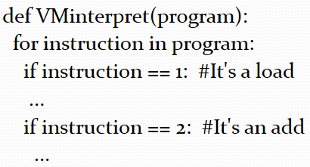
What Good is It to Run Only on a Computer That Doesn’t Exist?!?
Machine language is a very simple language.
A program that interprets the machine language of some computer is not hard to write.

Slide 33
Java Runs on Everything…
Everything that has a J V M on it!
Each computer that can execute Java has an interpreter for the Java machine language.
That interpreter is usually compiled to machine language, so it’s very fast.
Interpreting Java machine is pretty easy
Takes only a small program
Devices as small as wristwatches can run Java V M interpreters.

Slide 34
What Happens When You Execute a Python Statement in J E S
Your statement (like “show(canvas)”) is first compiled to Java!
Really! You’re actually running Java, even though you wrote Python!
Then, the Java is compiled into Java virtual machine language.
Sometimes appears as a .class or .jar file.
Then, the virtual machine language is interpreted by the J V M program.
Which executes as a machine language program (e.g., an .exe)

Slide 35
Is It Any Wonder That Python Programs in J E S are Slower?
Photoshop and Word simply execute.
As fast as 1.5 Gigahertz
Python programs in J E S are compiled, then compiled, then interpreted.
Three layers of software before you get down to the real speed of the computer!
It only works at all because 1.5 billion is a Really big number!

Slide 36
Challenge: What Makes a Program Fast? (1 of 2)
Which of these will run fastest?
A program in J E S to download Web pages from news sites.
A program in Java to download Web pages from news sites.
A compiled program to figure out the longest Web page on a given subject on news sites.
A program in J E S to combine a bunch of H T M L files into a big summary file.

Slide 37
Challenge: What Makes a Program Fast? (2 of 2)
Which of these will run Slowest?
A program in J E S to download Web pages from news sites.
A program in Java to download Web pages from news sites.
A compiled program to figure out the longest Web page on a given subject on news sites.
A program in J E S to combine a bunch of H T M L files into a big summary file.

Slide 38
Why Use an Interpreter?

Slide 39
Why Interpret? (1 of 2)
For us, to have a command area.
Compiled languages don’t typically have a command area where you can print things and try out functions.
Interpreted languages help the learner figure out what’s going on.
For others, to maintain portability.
Java can be compiled to machine language.
In fact, some V M s will actually compile the virtual machine language for you while running—no special compilation needed.

Slide 40
Why Interpret? (2 of 2)
But once you do that, the result can only run on one kind of computer.
The programs for Java (.jar files typically) can be moved from any kind of computer to any other kind of computer and just work.

Slide 41
More Than One Way to Solve a Problem
There’s always more than one way to solve a problem.
You can walk to one place around the block, or by taking a shortcut across a parking lot.
Some solutions are better than others.
How do you compare them?

Slide 42
Our Programs (Functions) Implement Algorithms
Algorithms are descriptions of behavior for solving a problem.
A program (functions for us) are executable interpretations of algorithms.
The same algorithm can be implemented in many different languages.

Slide 43
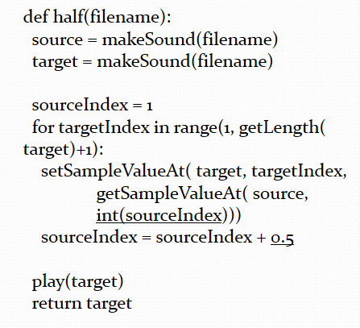
Recall These Two Functions (1 of 2)

Slide 44
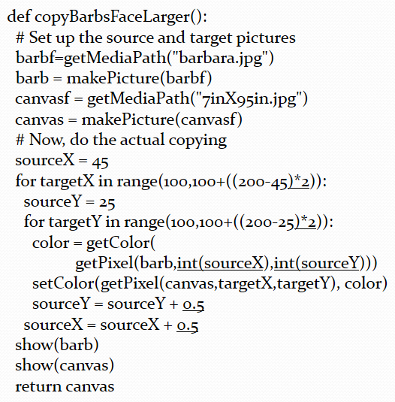
Recall These Two Functions (2 of 2)

Slide 45
Both of These Functions Implement a Sampling Algorithm
Both of them do very similar things:
Get an index to a source
Get an index to a target
For all the elements that we want to process:
Copy an element from the source at the integer value of the source index to the target at the target index
Increment the source index by
Return the target when completed
This is a description of the algorithm.

Slide 46
How Do We Compare Algorithms?
There’s more than one way to sample.
How do we compare algorithms to say that one is faster than another?
Computer scientists use something called Big-O notation
It’s the order of magnitude of the algorithm
Big-O notation tries to ignore differences between languages, even between compiled vs. interpreted, and focus on the number of steps to be executed.

Slide 47
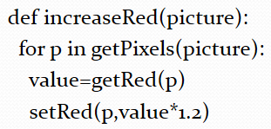
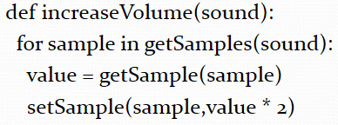
Which One of These is More Complex in Big-O Notation?
Neither – each one process each pixel and sample once.
As the data increases in size, the amount of time increases in the same way.

Slide 48
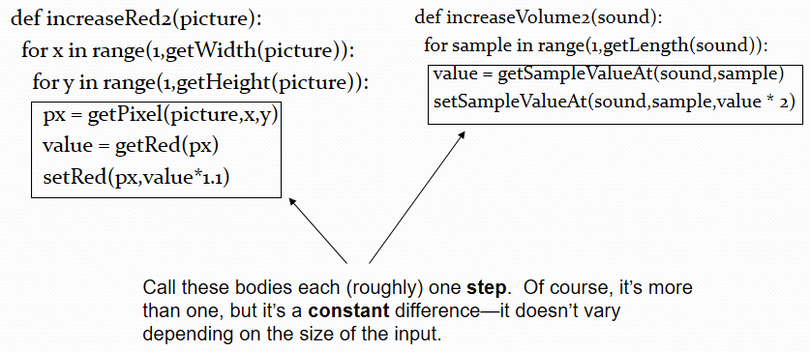
Spelling out the Complexity

Slide 49
Does It Make Sense to Clump the Body as One Step?
Think about it as the sound length increases or the size of the picture increases.
Does the body of the loop take any longer?
Not really
Then where does the time go? In the looping.
In applying the body of the loop to all those samples or all those pictures.

Slide 50
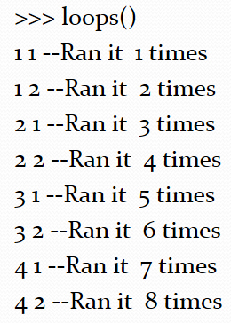
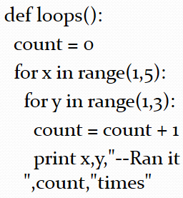
Nested Loops are Multiplicative

Slide 51
The Complexity in Big-O
The code to increase the volume will execute it’s body (the length) times.
If we call that n, we say that’s order n or
The code to increase the red will execute it’s body (the length)×(the height) times.
That means that the body is executed
That explains why smaller pictures take less time to process than larger ones.
You’re processing fewer pixels in a smaller picture.
But how do we compare the two programs?
because we address each pixel only once.
We would still call this

Slide 52
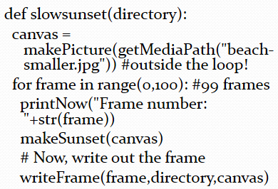
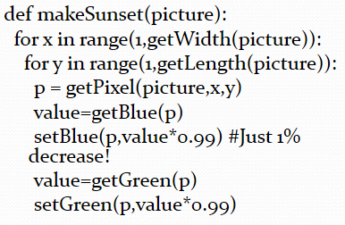
How About Movie Code?
The main function (slowsunset) only has a single loop in it (for the frames), but the makeSunset function has nested loops inside of it. But it’s still processing each pixel once.
There are just lots of pixels!

Slide 53
Why is Movie Code So Slow?
Why does it take longer to process movies than pictures?
Because it’s not just the nested loops of pictures
It’s usually three loops.
One for the frames.
Two to process the pixels
It’s still
but the n is big because it’s number of frames times the height of each frame times the width of each frame.

Slide 54
Sound vs. Pictures vs. Movies
Why isn’t sound code super-fast than?
We usually don’t have frames that are 22,000 pixels to a side (the number of samples in one second of sound at our lower resolution!)
The algorithmic complexity of all three, for the things we’re doing, is the same.
We touch each pixel or sample only once, so it’s

Slide 55
Not All Algorithms are the Same Complexity
There is a group of algorithms called sorting algorithms that place things (numbers, names) in a sequence.
Some of the sorting algorithms have complexity around
If the list has 100 elements, it’ll take about 10,000 steps to sort them.
However, others have complexity
The same list of 100 elements would take only 460 steps.
Think about the difference if you’re sorting your 10,000 customers…

Slide 56

Puzzle
You have six blocks.
One of them weighs more than the other.
You have a scale, but you can only use it twice.
Find the heaviest one.
How do you do it?

Slide 57
Finding Something in the Dictionary
Start from the beginning.
Check each page, until you find what you want.
Not very efficient
Best case: One step
Worse case: n steps where n = number of pages
Average case:

Slide 58
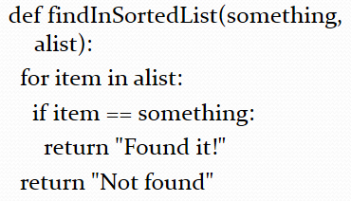
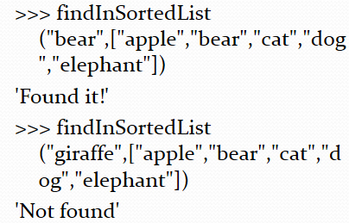
Implementing a Linear Search Algorithm

Slide 59
A Better Search in a Sorted List
Split the dictionary in the middle.
Is the word you’re at before or after the page you’re looking at?
If after, look from the middle to the end.
If before, look from the start to the middle.
Keep repeating until done or until it couldn’t be there.
More efficient:
Best case: It’s there first place you look.
Average and worst case: log n steps

Slide 60
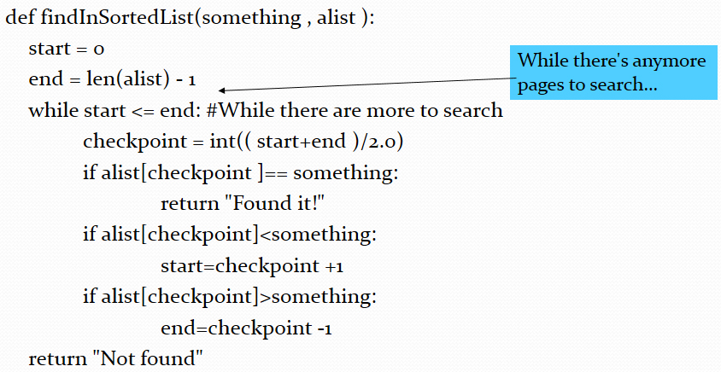
Implementing a Binary Search

Slide 61
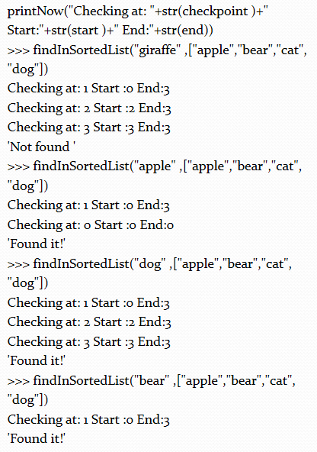
Running the Binary Search

Slide 62
Thought Experiment: Optimize Your Song
You’re writing a song that will be entirely generated by computer by assembling portions of other sounds.
Splicing one onto the end of the other.
You’ve got a bunch of bits of sound, say 60.
You want to try every combination of these 60 bits.
You want to find the combination that:
Is less than 2 minutes 30 seconds (optimal radio time)
And has the right amount of high and low volume sections (you’ve got a checkSound() function to do that.)

Slide 63
How Many Combinations are There?
Let’s ignore order for right now.
Let’s say that you’ve got three sounds a, b, and c.
Your possible songs are: c, b, bc, a, ac, ab, abc
Try 2 and 4, and you’ll see the same pattern we saw earlier with bits.
For n things, every combination of in-or-out is
If we ignore the empty combination, it’s

Slide 64
Handling Our 60 Sounds
Therefore, our 60 sounds will result in
combinations to test against our desired time and our time check
That’s 1,152,921,504,606,846,976 combinations.
Let’s imagine that we can test each one in only a single byte (unbelievable, but pretend).
On a 1.5 Gigahertz laptop, that’s 768,614,336 seconds

Slide 65
Spelling It out
768,614,336 seconds is 12,810,238 minutes
Divided by 24 is 8,896 days
Which is 24 years
But since Moore’s Law doubles the processor speed every 18 months, we’ll be able to cut that down to 12 years next year!
If we cared about order, too (abc vs. bca vs. cba…) we’d have to multiply the number of combinations by 7 followed by 63 zeroes.

Slide 66
Optimization is a Very Complex Problem
Trying to find the optimum combination of a set of things turns out to have so simple algorithm for it.
It always takes a very long time.
Other problems seem like they should be do-able, but aren’t.

Slide 67
Challenge
What is the Big-Oh of multiplying multi-digit numbers?

Slide 68
The Traveling Salesman Problem
Imagine that you’re a sales person, and you’re responsible for a bunch of different clients.
Let’s say 30—half the size of our optimization problem.
To be efficient, you want to find the shortest path that will let you visit each client exactly once, and not more than once.
Being a smart graduate of this class, you decide to write a program to do it.

Slide 69
The Traveling Salesman Problem Currently Can’t be Solved
The best known algorithm that gives an optimal solution for the Traveling Salesman Problem is
There are algorithms that are better that give close-to but not-guaranteed-best paths
For 30 cities, the number of steps to be executed is 265,252,859,812,191,058,636,308,480,000,000
The Traveling Salesman Problem is real.
For example, several manufacturing problems actually become this problem, e.g. moving a robot on a factory floor to process things in an optimal order.

Slide 70
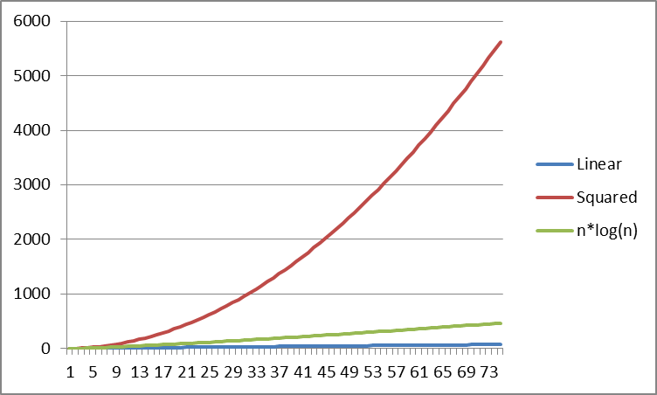
How Fast Big-Oh Functions Change (1 of 2)

Slide 71
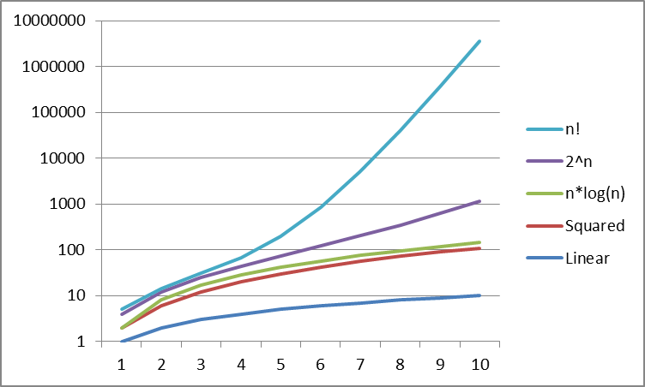
How Fast Big-Oh Functions Change (2 of 2)

Slide 72
Class P, Intractable, and Class N P
Many problems (like sorting) can be solved with an order of complexity that’s a polynomial, like
We call that Class P problems.
Other problems, like optimization, have known solutions but are so hard and big that we know that we just can’t solve them a reasonable amount of time for even reasonable amounts of data.
We call these intractable
Still other problems, like Traveling Salesman Problem seem intractable, but maybe there’s a solution in Class P that we just haven’t found yet.
We call these class N P
Notes:
The big CS question: Does P = NP? Can we solve NP problems in P time? A big class of common NP problems where if we solve one, we solve all: NP-Complete
The big CS question: Does P = NP? Can we solve NP problems in P time? A big class of common NP problems where if we solve one, we solve all: NP-Complete

Slide 73
Then There are Impossible Problems
There are some problems that are provably impossible.
We know that no algorithm can ever be written to solve this problem.
The most famous of these is the Halting Problem
Which is, essentially, to write a program to completely understand and debug another program.

Slide 74
The Halting Problem
We’ve written programs that can read another program and even write a new program.
Can we write a program that will input another program (say, from a file) and tell us if the program will ever stop or not?
Think about while loops with some complex expression—will the expression ever be false?
Now think about nested while loops, all complex…
It’s been proven that such a program can never be written.

Slide 75
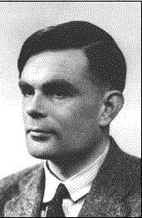
Alan Turing
Brilliant mathematician and computer scientist.
Came up with a mathematical definition of what a computer could do…before one was even built!
The Turing machine was invented in answer to the question of what the limits of mathematics were: What is computable by a function?
He proved that the halting problem had no solution in 1936—almost ten years before the first computers were built.
Notes:
http://www.digidome.nl/alan.htm Might mention the Enigma machine
http://www.digidome.nl/alan.htm Might mention the Enigma machine

Slide 76
Why is Photoshop Faster Than Python?
First, Photoshop is compiled.
Compiled programs run faster than interpreted programs.
Second, Photoshop is optimized.
Where things can be done smarter, Photoshop does it smarter.
For example, finding colors to be replaced can be made faster than the linear search that we used.

Slide 77
Can We Write a Program That Thinks?
Are human beings computable?
Can human intelligence be captured in an algorithm?
Yes, we can debug programs, but there may be some programs that are too complex for humans to debug—we may fall under the Halting Problem, too.
Is it Class P? Class N P? Intractable?
Are humans just computers in flesh?
These are questions that artificial intelligence researchers and philosophers study today.

Slide 78
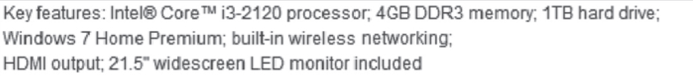
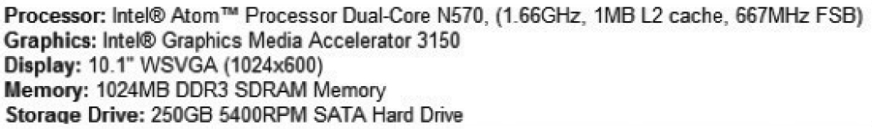
What Makes One Computer Faster Than Another?
When your read an advertisement for a computer, what does it mean?
What parts mean that the computer is fast?
Answer: Depends on what parts you will need to be fast!

Slide 79
Clock Rate is a Drill Sergeant
The clock yells “Go! Go! Go!” at a certain rate.
Faster “Go! Go! Go!” generally means faster execution, within the same kind of processor.
Some processors more efficient per “Go!”
Dual core means that there are two sergeants, two soldiers.
Can they do twice as much? If they work together well.
Quad core means four, and so on.

Slide 80
Storage Types
Cache memory is the space at your desk.
You can get to it fastest. Most expensive.
R A M storage (S D R A M) is the main memory.
1 megabyte is 1 million characters of memory.
1 gigabyte is 1 billion characters.
Slower than cache, much faster than disk.
R A M disappears when the power is turned off
Hard disk is slowest memory but is permanent.
It’s where you store your files.

Slide 81
Storage Relationships
If you have too little R A M, your computer will store some things on hard disk.
It will be slower to bring back into R A M for the computer to use it.
System bus describes how fast things can move around your computer.
Network is even slower than hard disk.
If you’re grabbing a web page from the network, onto the hard disk, and into R A M, the network speed will be the limiting factor.

Slide 82

Copyright

